Slide 1
Peoples’ Perception on the inclusion of ‘Transgenders’ in the workplace in Bangladesh
Made by:
Ishtiaque Hossain Sajid
1731485630

Slide 2
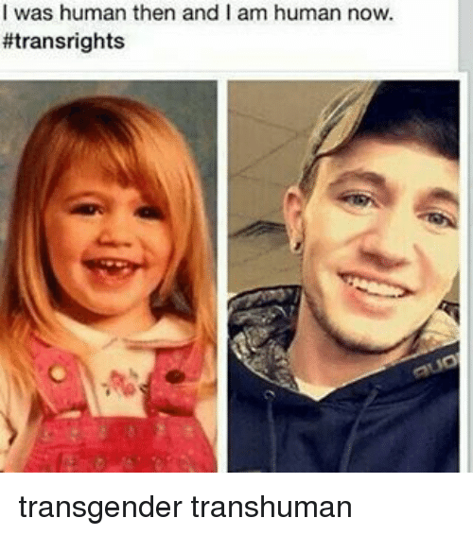
Definition
A person whose sense of personal identity and gender does not correspond with their birth sex

Slide 3
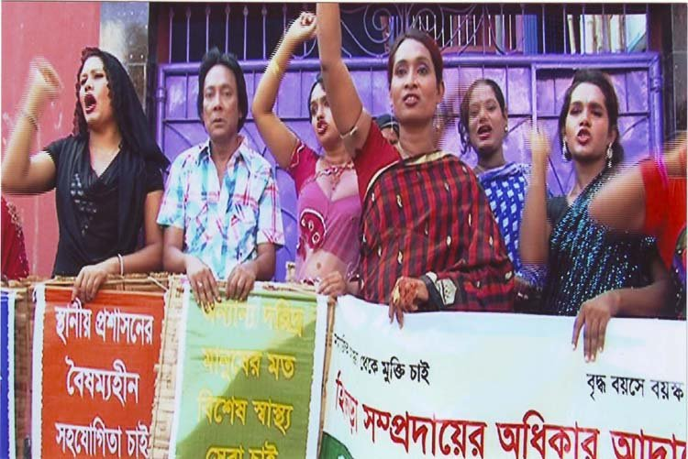
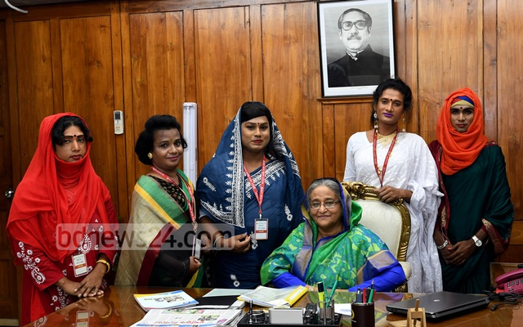
Background
Transgenders protesting for their rights
Transgenders getting recognized as 3rd gender in 2013

Slide 4
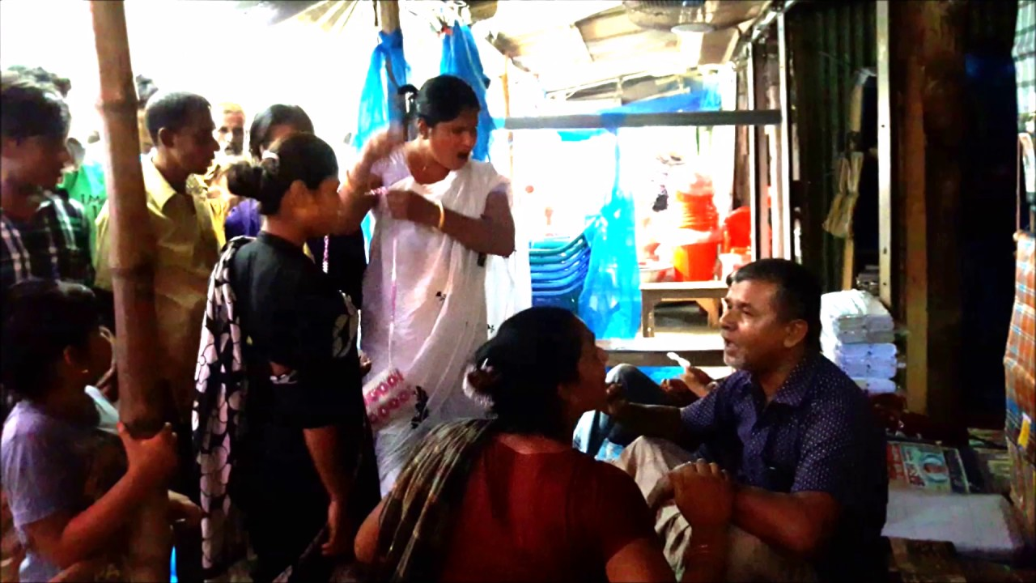
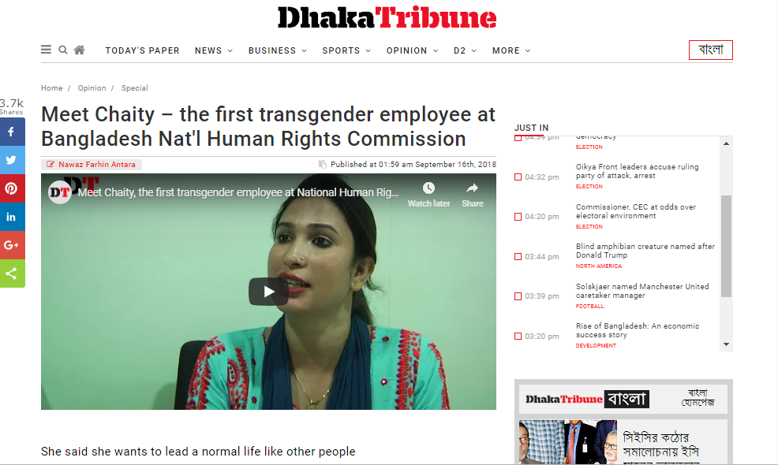
Background
Racketeering → Govt. Job

Slide 5
Areas of Research
What are the participants view on people who does not correspond to their birth sex?
How much close will the participants be with the transgenders?
How will they treat trans co-workers?
What amount of responsibility and authority does the transgenders deserves in the work place?

Slide 6
Hypothesis
It is expected that peoples’ view on transgenders will vary in par with ages.
The elderly will be against the transsexuals being involved in the society whereas the young generations will be much liberal and willing to work and socialize with them.
It is expected that even the young generations will feel uneasy to take orders from them.
A part of the participants will express that the laws of Bangladesh regarding transgenders rights and protections from discrimination are vague and insufficient.

Slide 7
Primary Data Presentation
 | A | B | C | D | E
1.Why do you think transgenders people are born? | 85.3% | 2.9% | 0 | 11.8%
2. Did you ever talk with any transgender? | 41.2% | 58.8%
3. If given the chance, would you like to talk with one? | 94.1% | 5.9%
4. Will you share any personal stories with any transgender given that you know him/her for some time and is trustworthy? | 76.5% | 23.5%
5. Do you see yourself following a transgender as your superior? | 67.6% | 32.4%
6. If any transgender is your sub-ordinate, how would you treat them? | 67.6% | 2.9% | 29.4%
7. How much qualification do you think a transgender need to reach in your current work position? | 67.6% | 11.8% | 20.6%
8. Do you think transgenders needs more opportunities to join the regular jobs? | 23.5% | 76.5%
9. Will you ever share an apartment with a transgender? | 76.5% | 23.5%
10. Why do you think transgender people don’t enter into studies and works like everybody else? | 79.4% | 5.9% | 14.7%
11. Will you take the risk of referring transgenders for employment/ grants/ studies to your superior, provided that they have potential? | 94.1% | 5.9%
12. If you find a transgender involved in conflict with a co-worker, what role will you play? | 21.2% | 6.1% | 60.6% | 0 | 12.1%

Slide 8
Education Level of respondents

Slide 9
Why do you think transgenders are born?

Slide 10
Did you ever talk with any transgender?

Slide 11
Will you share an apartment with a transgender?

Slide 12
How much qualifications do you think a transgender should need to reach in your work position?

Slide 13
If you have a transgender as your subordinate, how would you treat them?

Slide 14
Do you see yourself following a transgender as your superior?

Slide 15
If you find a transgender in conflict with a coworker, what role will you play?

Slide 16
Some Responses through open ended questions.
“Taking the social stigma in consideration a transgender might be harassed in the workplace. In such case I would listen to the victim's side of the story first.”
“They are also human being like us and they should be treated normally. And I won't share an apartment with a transgender just as I won't be comfortable sharing an apartment with a male. There is no hate issues.”
“Hmm Personally I can't be comfortable around them but i will treat them Equally and see them Equally.If they truly deserve what they want to seek I will support them but if they use their transgender problem as an excuse to get more benefit i can't tolerate it.”

Slide 17
“Transgenders are neglected in the society. Most of the people hate them, so they should be treated equal”
“Transgender are suffering because of a social stigma that we have around us.they should be given equal rights”
“Transgender are human being just like me..they face harsh social Stigma,they deserve equal Opportunities and freedom.”
“Transgenders are also like us, a human being. Just because they were born like this, doesn't mean they are to be ignored or criticized. Unlike the others seen on streets, there are many transgenders who are very nice as a person, born in a respectful family.”

Slide 18
Summary of Research Findings
Hypothesis was confirmed for most of the cases but, one was proved to be wrong.
Among the respondents, all the graduates said that they do not see themselves following a transgender.
They think the transgenders should not receive extra benefits of requiring less qualifications than them.
Furthermore, if they find a transgender in conflict with a coworker, 66.7% of them said they will just ignore the situation as if nothing happened, the rest said they will ask both the coworker and transgender person to resolve the situation.

Slide 19
The graduates i.e. people over 25 are seen reluctant to follow a transgender superior.
Through the open-ended questions and opportunity available questions too respondents said they feel the rights and laws available for the transgenders are not good enough.
But in the case of “even younger generation will feel uneasy to take orders from the transgender” has been proven wrong, as they opined, they are willing to follow a superior transgender.

Slide 20
Limitations
Exact secondary data could not be collected as dedicated independent data collectors on this field are not available.
Due to time constraints, transgenders could not be contacted for their own opinion.
Perspective of the root people can only be known by extensive field research. Unfortunately, that could not be done.
People from all ages and profession needs to be surveyed for generating sample representing whole country, but the respondents were in the age group of 17-35.

Slide 21
Conclusion
This research indicates that the modern people of the society are very much aware about the status of transgenders. They do not express hatred towards them rather are willing to offer open arms to them so that they can avail their equal rights.
The exploitation that goes on around them in the root level must be stopped through Governments initiative and the modern youth should also step up to help the transgenders however they can.

